Slide 1
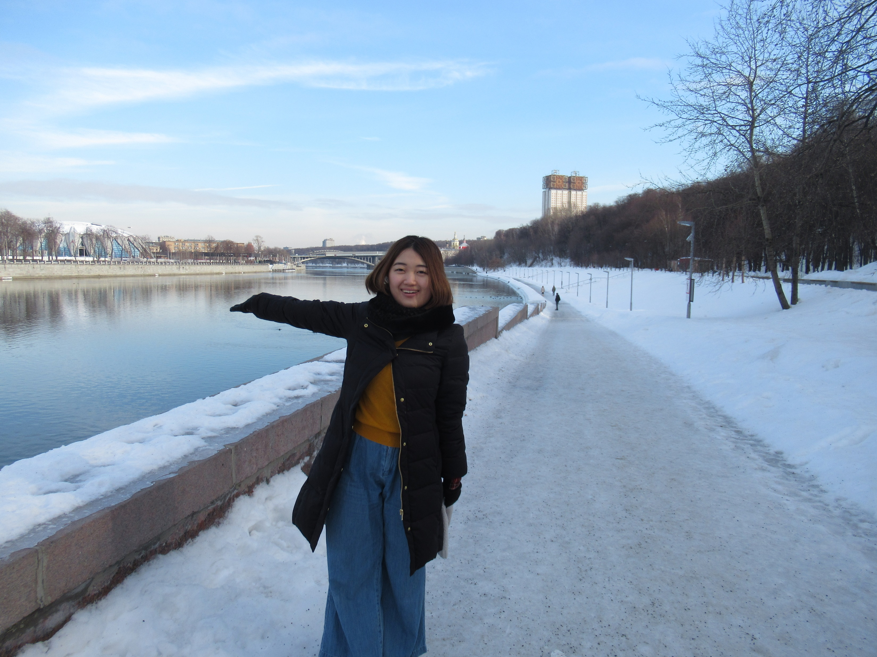
Moscow City,
From a view point of a Japanese student
Yu Saito
University of Tokyo

Slide 2
Introduction
Comparison between Moscow and Tokyo by numbers
  size, population
Comparison between Moscow and Tokyo by maps
  the structure of city
  Moscow – the iconic form ‘circle’
  Tokyo – rather deformed structure
Notes:
1147 - The first mention in the Historical Chronicles is made about the city of Moscow, which was founded by Russian prince Yury Dolgoruky.

Slide 3
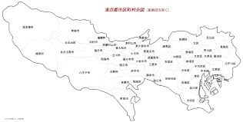
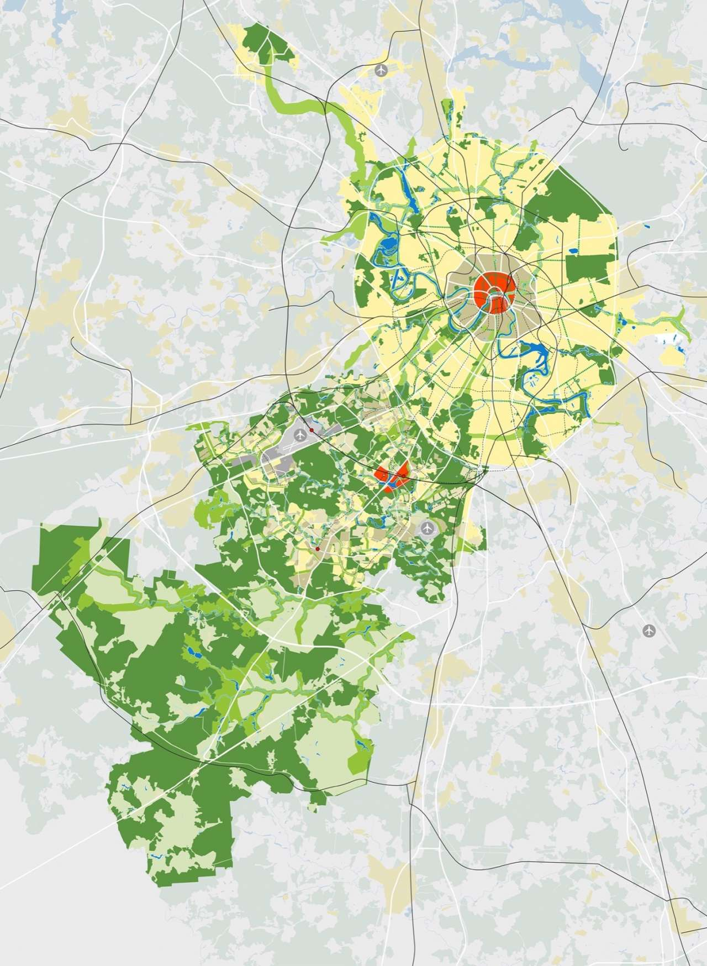

Introduction
Comparison between Moscow and Tokyo by numbers
  Size
    Tokyo District: 2190 $km^{2}$
    Moscow: 2,511 $km^{2}$ (in 2012) / around 1,000 $km^{2}$ (before 2012)
  Population
    Tokyo District: 13.8 million
    Moscow: 12.2 million
  Population Density
    Tokyo District: 6,320 people/ $km^{2}$
    Moscow: 5700 people/ $km^{2}$

Slide 4
Introduction
Comparison by maps

Slide 5
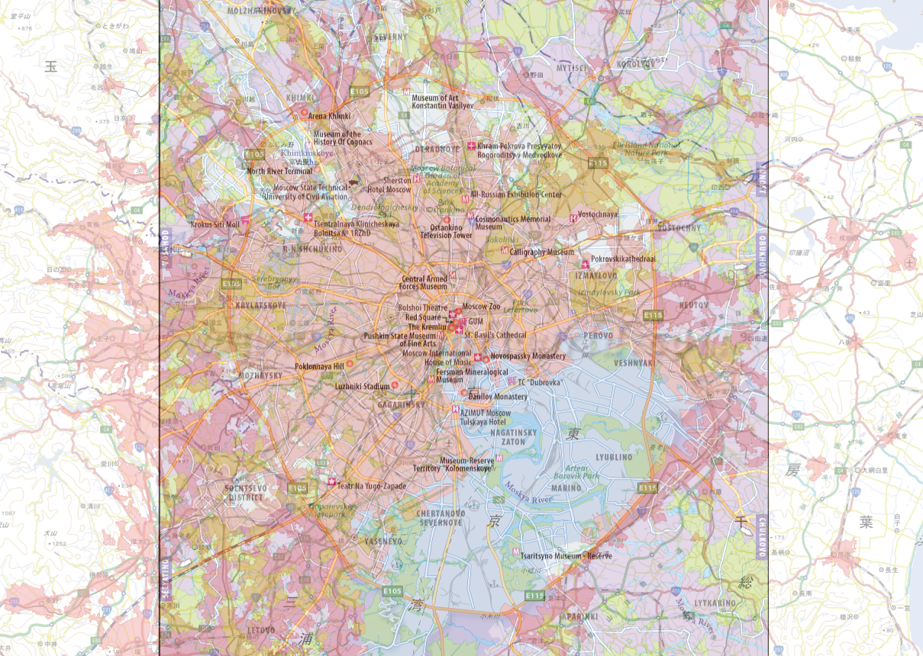

Slide 6
Method
Walking Survey
  spots / impression
Interview
  with Mr. Kudrietsev / with Ms. Loginova
Questionnaire
  recommendations of participators
  their impression on Moscow city

Slide 7
Result —— walking survey
Impression on the city
  Long and huge historical periods are barely integrated into one city
  Rather for pedestrians, not for cars or bikes
  Meanwhile, metro transportation is well operated

Slide 8
Result —— interview
History of Moscow - Meeting with Mr. Kudrievtsev
Comparison between Moscow and Tokyo from history
  the year of establishment
    Moscow – 1147(the first mention in the Historical Chronicles is made about the city of Moscow)
    Tokyo – 1603 (the establishment of Edo Shogunate)
  main modifications to the city
    Moscow
    – becoming the capital of all Russia
    – coming to serve as a second capital (the capital moved to St. Petersburg)
    – the big fire of 1812 during the Patriotic War
    – Stalin’s policy on construction in 1935
    Tokyo – Edo Shogunate, Meiji government, Great Kanto Earthquake of 1923,
    bombing during WWⅡ, post-war development

Slide 9
Result —— interview
Efforts to preserve the historical context in Moscow city
Meeting with Ms. Loginova
Recent Impact on historical sites in Moscow
  destruction after the death of Lenin and Stalin
  practical functions implemented into historical buildings
Main Goals of her work
  clarifying the subject of restoration
  ‘restoration aimed at recovering original condition’
  the balance between adaptation of modern instruments and preservation
Recent policy of Moscow city government

Slide 10
Result —— questionnaire
Historical Symbol of Moscow
  Kremlin (all of 5 answers)
Complaints about Moscow city
  busy, nervous
alone in the crowd
Modern metropolis
i love it
Beautiful architectural disorder
Beautiful,
Moscow in a few words

Slide 11
Discussion
The image of Moscow city is composed of huge and abundant history
We can see the great contrast between a variety of historical periods
at a glance to the city’s scenery
‘You should not visit Kremlin first’ – Ms. Loginova
Recent efforts to preserve the huge historical context of Moscow city
Development of new parts of cities are happening at the same time
Recent efforts to make use of historical sites for inhabitants’ comfort
Remained problems for inhabitants – traffic jam, sanitation

Slide 12
Discussion
Japanese might not well understand this attractiveness of Moscow city, which is the capital of one of the important neighborhood countries (from my view)
Needed: Survey into the general impression on Moscow city from Japanese
  impressions derived from the domain of art
    drawings and photographs of Moscow city
    literature in which Moscow is depicted
    ballet, opera, concert

Slide 13
Discussion
Statement:
Not only for tourism,
but also for the friendship between Russian and Japanese,
the image of Moscow city should be clarified to Japanese people.

